Slide 1
UNIX AND SHELL PROGRAMMING
Presented by G.Ramnath
BAS Academy

Slide 2
Course Overview
Introduction
Unix file system & Commands
VI Editor
Simple Filters
Process
Redirection
Some more useful commands
Sed & AWK
Shell Programming
Other Application Interface

Slide 3
Introduction

Slide 4
What is an Operating System?
A program that acts as an intermediary between a user of a computer and the computer hardware.
Operating system goals:
Execute user programs and make solving user
problems easier.
Make the computer system convenient to use.
Use the computer hardware in an efficient manner.

Slide 5
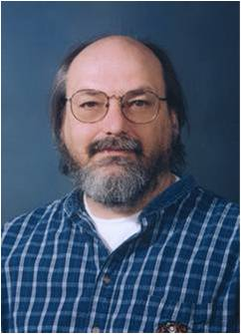

Creators of Unix
Ken Thompson (left) and Dennis Ritchie (right)
Turing award in 1983
Notes:
5

Slide 6

Linux History
Linux: free Unix-like kernel
can run almost all programs written for Unix
developed by Linus Torvalds, University of Helsinki, in 1992
small part of usable Linux system
Notes:
6

Slide 7



Linux System
Linux kernel + many free tools
ready-to-install distributions (flavors)
RedHat, Fedora, Debian
GNU project
free software, mass collaboration project
GNU (GNU’s Not Unix), use Linux as kernel
GCC, G++, bash, GNU Emacs ...
Copyleft
Richard Stallman
Notes:
7

Slide 8
The UNIX operating system
UNIX Architecture - Block diagram
Other application programs
as
ed
sh
Kernel
who
cpp
open fork exec
cc
comp
Hardware
vi
ld
a.out
date
grep
Other application programs
Notes:
8

Slide 9
The UNIX operating system Cont..
Kernel
Core of the OS – a collection of routines/system calls written in C
Loaded into memory when the system is booted
Communicates with the hardware directly
Shell
Interface between the user and the kernel
Acts as the command interpreter
Forms a simpler version of the command line and communicates with the kernel to see that command is executed

Slide 10
Loging in & Logging Out
Loging in
To login in to the UNIX system, one should have an user account on the system.
The user account must be created by UNIX administrator also called as Super user or root
Logging in to the UNIX system requires two pieces of information
A username, and
A password
When your account is created, a password is assigned. To change your password, type the command “passwd”
Loging out
Once you are done using the system, you can logout by typing “exit” at the shell prompt.
Some shells will recognize other commands to log you out, like "logout" or even "bye".

Slide 11
Loging in to a remote system
If you have several UNIX systems at your site connected together by a network and If you have accounts on these remote systems you can login to them from the system you are currently using.
Use rlogin or telnet to log in to remote system
Loging-in using rlogin
To login to your account on a remote system use the command:
rlogin remote_system_name
To login to a remote system using a different username, use the command:
rlogin remote_system_name -l username

Slide 12
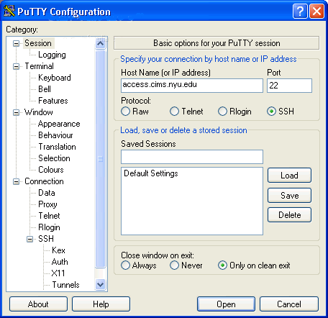
Remote Login
Use Secure Shell (SSH)
Windows
e.g. PuTTY
UNIX-like OS
ssh name@access.cims.nyu.edu
Notes:
12

Slide 13
Unix File System & Commands

Slide 14
The UNIX File System
A file system is a logical method for organizing and storing large amounts of information in a way which makes it easy to manage.
There can be more than one file systems on any UNIX operating systems
There can be more than one type of file systems
Each disk file system on the UNIX operating system will have the following structure

Slide 15
UNIX File System structure

Slide 16
The UNIX file system
Hierarchical file system
UNIX file system comprises of a tree like structure consists of files and directories.
It is logically organized into meaningful structure of directories, with each directory containing files and sub-directories

Slide 17
UNIX File system
The standard system directories of the UNIX file system are shown below.
Each directory below contains specific types of file.

Slide 18
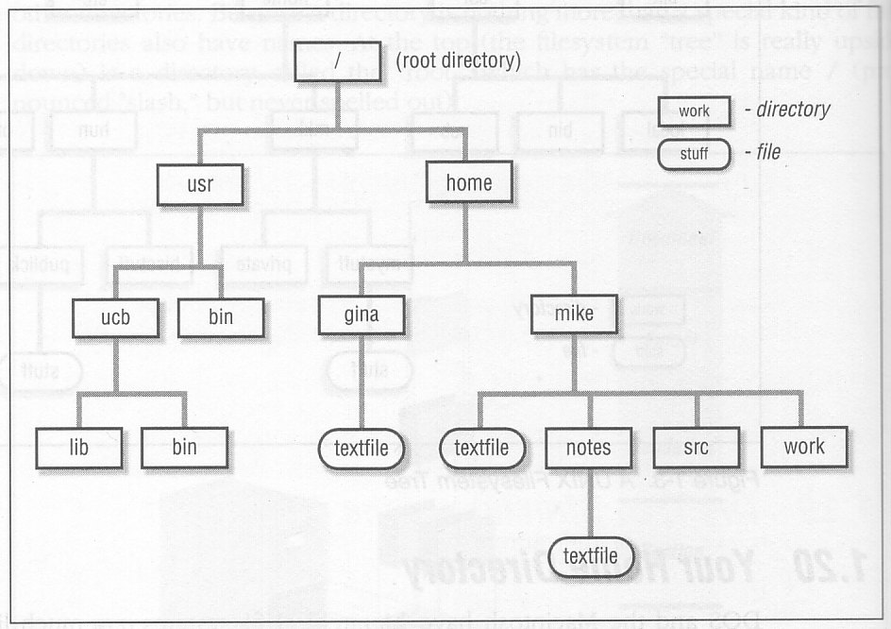
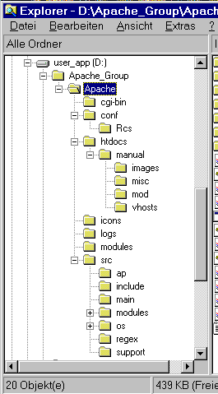
The UNIX File Hierarchy
The PATH environment variable
.profile
Notes:
18

Slide 19
The UNIX File System - Files
File is the smallest unit in which information is stored.
The file name is a reference to the information stored on the file system.
UNIX-legitimate filenames are any combination of these three classes of characters
Upper and lower case letters ( A - Z and a - z )
Numbers ( 0 - 9 )
Periods, underscores, hyphens ( . _ - )
UNIX file names are case sensitive
Examples:
Good Filenames
“records.010802” A legitimate UNIX filename
“records.010802” Different from above because of the capital F
Bad Filenames
“records 01-08-02 “ Two files, one called "records" another called " 01-08-02 “ because of the line space between the words.
“records-01/08/02“ A mess because the Unix shell will attempt to interpret the slash characters as directory delimiter.

Slide 20
Path names
A pathname is a sequence of directories that lead to the file. A pathname can be either Absolute pathname or Relative pathname
Absolute pathname
With reference to the root directory “/”
Each obsolete pathname is unique on an UNIX system
Relative pathname
The name is relative to the current working directory
The path is valid only from that particular directory

Slide 21
UNIX - Commands
UNIX command is an executable program
The basic form of any Unix command is:
command_name options argument(s)
Most descriptions for commands such as those given in the On-line manual use a much more precise syntax. For example:
cp [-iprR] filename ... directory
This syntax has a few simple rules, which will help us understand how that command is to be used

Slide 22
man pages
UNIX offers an online help facility in the man command.
man displays the documentation of the specified command.
Example:
$ man wc displays help on wc command
man uses a pager program, which displays this documentation one page at a time
man is configured to be used with a specific pager.
Two available pagers are:
more, a Berkeley pager, as an alternative to the AT&T pg command
less, the standard pager on Linux systems, also available on UNIX. It is modeled after vi editor and is more powerful than more..

Slide 23
Where are commands located & Connecting Commands
Unix commands are executable binary files located in directories with the name bin (for binary). Many of these are located in the directory /usr/bin.
When you enter the name of a command the shell checks to see if it is a built-in command.
If it is not, it looks for the the binary file that the command name refers to in each of the directories that are defined in the PATH environment variable.
which and whereis commands
Unix allows you to link two or more commands together using a pipe.
The pipe takes the standard output from one command and uses it as the standard input to another command.
Example : command1 | command2 | command3
The | (vertical bar) character is used to represent the pipeline connecting the commands.

Slide 24
Useful Commands
cd – change directory (The tilda (~) represents your home directory. )
pwd – present working directory
mkdir - make directories
Syntax: mkdir [OPTION] DIRECTORY...
Options: -m=mode, -p
rmdir - make directories
rm - remove files or directories
Syntax: rm [OPTION]... FILE...
Options:i,f,r,v

Slide 25
Useful Commands
cp - copy files and directories
Syntax:
cp [OPTION]... SOURCE DEST
cp [OPTION]... SOURCE... DIRECTORY
Options:i,p,f,r,R,s,u
mv - move (rename) files
Syntax:
mv [OPTION]... SOURCE DEST
mv [OPTION]... SOURCE... DIRECTORY
Options: b,i,f,u

Slide 26
Some useful UNIX Commands
l – long listing
a – all files including hidden files
F – Flag file types
C – lists files in Columns
d – lists only directory information
ls - Lists directory contents
Syntax:
ls [OPTIONS]... [FILE]...
Options:
i – Lists I-node for each file
R – lists files in all subdirectories
r – Lists files in reverse order
t – list with modification time stamp
1 – print 1 line of output per line

Slide 27
File permissions
The above two lines have 9 columns each, the table describes what they are
The first character indicates the type of the file as described below.
- : It is a regular file
d: It is a directory
l : It is a link to a file

Slide 28
File permissions
The next 3 fields (9 characters) indicate the file access permissions for each kind of users to the file, and are represented by a set of 3 octal digits.
rwx - for owner (first digit)
rwx - for group (second digit)
rwx - for the other (third digit)
Each character means the following
r - can read the file
w - can edit the file
x - execute the file
- can not
You can change/modify the permissions of the file using the chmod command, which will be discussed latter.
Notes:
28
Add some examples to add, modify and remove the permissions

Slide 29
Chmod – Chage Mode
Chmod <options> <args>
Octal Permissions Significance
0 - - - no permissions
1 - - x execute only
2 - w - write only
3 - w x write and execute
4 r - - read only
5 r - x read and execute
6 r w - read and write
r w x read, write and execute
Using relative permission
chmod a+rw xstart
Using absolute permission
chmod 666 xstart
chmod 644 xstart
chmod 761 xstart will assign all permissions to the owner, read and write permissions for the group and only execute permission to the others

Slide 30
Chown & chgrp
chown
Changing ownership requires superuser permission, so use su command
ls -l note
-rwxr----x 1 kumar metal 347 may 10 20:30 note
chown sharma note; ls -l note
-rwxr----x 1 sharma metal 347 may 10 20:30 note
chgrp
This command changes the file’s group owner
No superuser permission is required
ls –l dept.lst
-rw-r--r-- 1 kumar metal 139 jun 8 16:43 dept.lst
chgrp dba dept.lst; ls –l dept.lst
-rw-r--r-- 1 kumar dba 139 jun 8 16:43 dept.lst

Slide 31
VI EDITOR

Slide 32
Vi - Special keys

Slide 33
Vi – Mode changing commands

Slide 34
Vi – Saving and exiting

Slide 35
Vi Cursor motion commands

Slide 36
VI text delete commands

Slide 37
Vi – Yank and put commands

Slide 38
Vi – Replace commands

Slide 39
Vi – Search commands

Slide 40
Vi – Undo command
In the real vi, the undo command only undoes the last command, even if that is an undo command.
Repeated undo commands simply toggle the effect of the last command before the series of undo commands.
Some vi clones, such as vim, allow multiple undo's.
R –redo
S-substitution
Vi Misc
Repeat command (.)
Join lines (J)
:Set command
Vi configuration file (.exrc)

Slide 41
SIMPLE FILTERS

Slide 42
head
Displays the top of the file
It displays the first 10 lines of the file, when used without an option
head emp.lst
-n to specify a line count
head -n 3 emp.lst

Slide 43
tail
Displays the end of the file
It displays the last 10 lines of the file, when used without an option
tail emp.lst
-n to specify a line count
tail -n 3 emp.lst
Monitoring the file growth (-f)
Extracting bytes rather than lines (-c)

Slide 44
cut
It is used for slitting the file vertically
head -n 5 emp.lst | tee shortlist
will select the first five lines of emp.lst and saves it to shortlist
We can cut by using -c option with a list of column numbers, delimited by a comma (cutting columns)
cut -c 6-22,24-32 shortlist
cut -c -3,6-22,28-34,55- shortlist

Slide 45
cut
Most files don’t contain fixed length lines, so we have to cut fields rather than columns (cutting fields)
-d for the field delimiter
-f for the field list
cut -d \ | -f 2,3 shortlist | tee cutlist1
will display the second and third columns of shortlist and saves the output in cutlist1. here | is escaped to prevent it as pipeline character
To print the remaining fields, we have
cut –d \ | -f 1,4- shortlist > cutlist2

Slide 46
paste
When we cut with cut, it can be pasted back with the paste command, vertically
paste cutlist1 cutlist2
We can view two files side by side
We can specify one or more delimiters with -d
paste -d “|” cutlist1 cutlist2
Where each field will be separated by the delimiter |

Slide 47
Sort : ordering a file
Sorting is the ordering of data in ascending or descending sequence. The sort command orders a file and by default, the entire line is sorted
Example:
sort shortlist
-tchar uses delimiter char to identify fields
-k n sorts on nth field
-k m,n starts sort on mth field and ends sort on nth field
-k m.n starts sort on nth column of mth field
-u removes repeated lines
-n sorts numerically
-r reverses sort order
-f folds lowercase to equivalent uppercase
-m list merges sorted files in list
-c checks if file is sorted
-o flname places output in file flname

Slide 48
Sort : ordering a file Cont…
sort –t“|” –k 2 shortlist
sort –t”|” –r –k 2 shortlist or
sort –t”|” –k 2r shortlist
sort –t”|” –k 3,3 –k 2,2 shortlist
sort –t”|” –k 5.7,5.8 shortlist
sort –n numfile

Slide 49
uniq command
Locate repeated and non-repeated lines
cat dept.lst
uniq dept.lst
sort : dept.lst | uniq - uniqlist
Selecting the nonrepeated lines (-u)
Selecting the duplicate lines (-d)
Counting frequency of occurrence (-c)

Slide 50
tr command
Manipulates the individual characters in a line. It translates characters using one or two compact expressions
tr options expn1 expn2 standard input
It takes input only from standard input, it doesn’t take a filename as argument
tr ‘|/’ ‘~-’ < emp.lst | head –n 3

Slide 51
grep
It scans the file / input for a pattern and displays lines containing the pattern, the line numbers or filenames where the pattern occurs
It’s a command from a special family in UNIX for handling search requirements
grep options pattern filename(s)
grep options
-i ignores case for matching
-v doesn’t display lines matching expression
-n displays line numbers along with lines
-c displays count of number of occurrences
-l displays list of filenames only
-e exp specifies expression with this option
-x matches pattern with entire line
-f file takes pattrens from file, one per line
-E treats pattren as an extended RE
-F matches multiple fixed strings

Slide 52
egrep
ch+ matches one or more occurrences of character ch
ch? Matches zero or one occurrence of character ch
exp1|exp2 matches exp1 or exp2
(x1|x2)x3 matches x1x3 or x2x3

Slide 53
Process

Slide 54
What is a Process
A running program in UNIX is called a process. Because UNIX is a multitasking system, many processes can run at the same time.
A process is said to be born when the program starts execution. After the execution is complete, the process is said to die.
Two important attributes of a proess are,
The process-id (PID): a unique identification number used to refer to the process.
The parent PID (PPID): the number of the process (PID) that started this process.
A process can be suspended, moved to the background or even be killed

Slide 55
ps: Process Status
The process ID is simply a number that uniquely identifies each
running process.
To see what process IDs are associated with your process, use
the ps command.
$ ps
PID TTY TIME CMD 17717 pts/10 00:00:00 bash 27501 pts/10 00:00:01 find 27502 pts/10 00:00:00 ps
Here the login shell isn’t doing much work, its CPU usage is negligible.

Slide 56
ps options
POSIX Option | BSD Option | Description
-f | F | Full Listing showing PPID of each process
-e or –A | aux | All processes including user and system processes
-u usr | U usr | Processes of usr only
-a |  | Processes of all users excluding system processes
-l | l | Long listing showing memory-related information
-t term | t term | Processes running on terminal term (say /dev/console)

Slide 57
ps -f
$ ps -f
UID PID PPID C STIME TTY TIME CMD srm 17717 1 0 15:57:07 pts/10 0:00 bash srm 27501 3211 0 15:16:16 pts/10 0:01 find srm 27502 2187 0 16:35:41 pts/10 0:00 ps –f
UID – Login name of the user
PID – Process ID
PPID – Parent process ID
C – An index of recent processor utilization, used by kernel for scheduling
STIME – Starting time of the process in hours, minutes and seconds
TTY – Terminal ID number
TIME – Cumulative CPU time consumed by the process
CMD – The name of the command being executed
Background jobs: &

Slide 58
Killing processes with Signals
To use kill, use either of these forms:
kill PID(s) OR kill –s NUMBER PID(s)
To kill a process whose PID is 123 use,
$ kill 123
To kill several processes whose PIDs are 123, 342, and 73 use,
$ kill 123 342 73
Issuing the kill command sends a signal to a process. The default signal is SIGTERM signal (15). UNIX programs can send or receive more than 20 signals, each of which is represented by a number. (Use kill –l to list all signal names and numbers)
If the process ignores the signal SIGTERM, you can kill it with SIGKILL signal (9) as,
$ kill -9 123 OR $ kill –s KILL 123

Slide 59
Job Control
A job is a group of processes. A job is created by running a
pipeline of two or more commands. You can use job control
facilities to,
Relegate a job to the background (bg)
Bring it back to the foreground (fg)
List the active jobs (jobs)
Suspend a foreground job ([Ctrl-z])
Kill a job (kill)

Slide 60
Some more UNIX Utilities (Backup)
The uname utility
The finger utility
The clear utility
Process State
Kill Process
Parent Wait for children
Sleep
All the user status
The date utility
The bc utility
The expr utility
The cal/calendar utilities
The ping utility
Process Commands
Ps
Kill
Wait
Sleep
top

Slide 61
Cron
cron looks for instructions to be performed in a control file in
/var/spool/cron/crontabs
After executing them, it goes back to sleep, only to wake up the next minute.
To a create a crontab file,
First use a editor to create a crontab file say cron.txt
Next use crontab command to place the file in the directory containing crontab files. crontab will create a file with filename same as user name and places it in /var/spool/cron/crontabs directory.
Alternately you can use crontab with –e option.
You can see the contents of your crontab file with crontab –l and remove them with crontab –r.

Slide 62
A typical entry in crontab file
minute hour day-of-month month-of-year day-of-week command
Time-Field Options for the crontab Command
Field Range
-----------------------------------------------------------------------------------------------
minute 00 through 59 Number of minutes after the hour
hour 00 through 23 (midnight is 00)
day-of-month 01 through 31
month-of-year 01 through 12
day-of-week 01 through 07 (Monday is 01, Sunday is 07)
-----------------------------------------------------------------------------------------------
The first five fields are time option fields. You must specify all five of these fields. Use an asterisk (*) in a field if you want to ignore that field.

Slide 63
A typical entry in crontab file
00-10 17 * 3.6.9.12 5 find / -newer .last_time –print >backuplist
The find command will be executed very minute in the first 10 minutes after 5 p.m. every Friday of the months March, June, September and December of every year.
To sort a file named /usr/wwr/sales/weekly and mail the output to a user named srm at 7:30 a.m. each Monday,
30 07 * * 01 sort /usr/wwr/sales/weekly |mail -s”Weekly Sales” srm

Slide 64
Customizing the Environment
The Shell
UNIX shell is both an interpreter and a scripting language.
An interactive shell runs a non-interactive shell when executing a shell script.
Bourne Shell – Strong programming features, weak interpreter.
C Shell – Improved interpretive features, wasn’t suitable for programming.
Korn Shell – Combines best of the two. Has features like aliases, command history. But lacks some features of C.
Bash Shell – Superset that combined the features of Korn and C Shells. Conforms to POSIX shell specification.
Environmental Variables
Shell variables are of two types: Local and environment.
PATH, HOME, SHELL etc. are examples of environment variables.
To include the directory /home/ahm/bin in the search use,
PATH=$PATH:/home/ahm/bin

Slide 65
The initialization scripts
The effect of assigning values to variables, defining aliases and using set options is applicable only for the login session; they revert to their default values when the user logs out.
To make them permanent, use certain startup scripts.
The startup scripts are executed when the user logs in.
.profile (Bourne shell)
.profile and .kshrc (Korn shell)
.bash_profile (or .bash_login) and .bashrc (Bash)
.login and .cshrc (C shell)
You can also execute them by using a special command (called dot).
$ . .profile

Slide 66
The Shell’s Wild-cards
Wild-card | Matches
* | Any number of characters including none
? | A single character
[ijk] | A single character – either i, j or k
[x-z] | A single character that is within ASCII range x and z
[!ijk] | A single character that is not an i, j or k (Not in C Shell)
[!x-z] | A single character that is not within the ASCII range x and z (Not in C shell)
{pat1,pat2…} | Pat1, pat2, etc. (Not in Bourne shell)

Slide 67
Example
Wild-card | Matches
* | Any number of characters including none
? | A single character
[ijk] | A single character – either i, j or k
[x-z] | A single character that is within ASCII range x and z
[!ijk] | A single character that is not an i, j or k (Not in C Shell)
[!x-z] | A single character that is not within the ASCII range x and z (Not in C shell)
{pat1,pat2…} | Pat1, pat2, etc. (Not in Bourne shell)

Slide 68
Escaping and Quoting
Escaping: Providing a \ (backslash) before the wild-card to remove its special meaning.
Quoting: Enclosing the wild-card, or even the entire pattern, within quotes. Anything within these quotes (barring a few exceptions) are left alone by the shell and not interpreted.
echo ‘$HOME’ displays $HOME

Slide 69
Redirection

Slide 70
Redirection: The three standard files
In the context of redirection, the terminal is a generic name that
represents the screen or keyboard.
We see the command output and error messages on the terminal
and provide command input through the terminal (keyboard). The
shell associates three files with the terminal. These files are
actually streams of characters which many commands see as
input and output.
There are three standard streams:
Standard input – The file (stream) representing input, connected to keyboard.
Standard output – The file (stream) representing output, connected to display.
Standard error – The file (stream) representing error messages that emanate from the command or shell, connected to display.

Slide 71
Three Special Files
Each of these three special files are represented by a number called, a file descriptor. A file is opened by using its pathname, but subsequent read and write operations identify the file by this file descriptor.
The kernel maintains a table of the file descriptors. The first three slots are allocated to the three standard streams.
0 – Standard Input
1 – Standard Output
2 – Standard Error

Slide 72
Standard Input
When a command is used without arguments, it reads the file representing the standard input. It can represent three input sources viz.,
The keyboard, the default source
A file using redirection with the < symbol
Another program using a pipeline
Example:
wc (without any arguments)
wc < sample.txt
ls | wc

Slide 73
Standard Output
All commands displaying output on the terminal actually write to the standard output file as a stream of characters. There are three possible destinations of this stream:
The terminal, the default destination
A file using the redirection symbols > and >>
As input to another program using a pipeline
Example:
wc sample.txt
wc sample.txt > outputFile
who | wc –l
cat *.c > all_C_progs.txt

Slide 74
Standard Error
When you enter an incorrect command, or try to open nonexistent file, certain diagnostic messages show up on the screen. This is the standard error stream.
For example, trying cat on a nonexistent file produces the error stream.
We can redirect this stream to a file. But, standard error cannot be redirected in the same way standard output can be (with > or >>). To capture the standard error and redirect to a file we have to use 2> symbols.
Example:
cat file1 2> errorfile
cat file2 2>> errorfile

Slide 75
/dev/null AND /dev/tty
/dev/null
If you would like to execute a command but don’t like to see its contents on the screen, you may wish to redirect the output to a file called /dev/null.
It is a special file that can accept any stream without growing in size. It’s size is always zero.
/dev/tty
This file indicates one’s terminal.
In a shell script, if you wish to redirect the output of some select statements explicitly to the terminal. In such cases you can redirect these explicitly to /dev/tty inside the script.

Slide 76
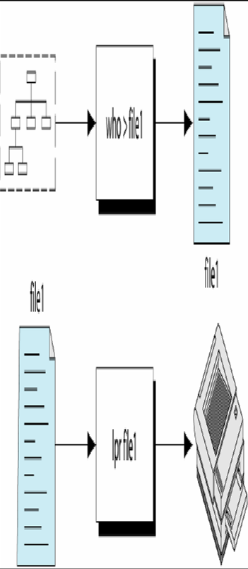
Pipes
UNIX without pipes is almost unthinkable
With piping, the output of a command can be used as input (piped) to a subsequent command.
Example: to print a list of users logged into the system.
Without pipes,
$ who > file1
$ lpr file1

Slide 77
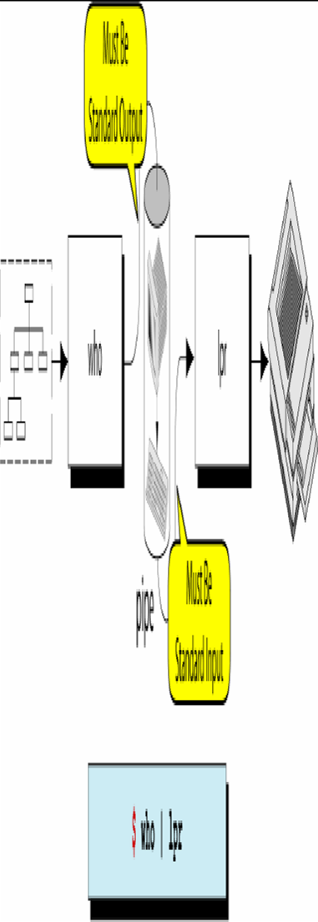
Pipes cont…
Example: to print a list of users logged into the system.
With pipes,
$ who | lpr

Slide 78
Some More
Useful Commands

Slide 79
Useful Commands
ln - make links between files (hard and soft link)
Syntax:
ln [OPTION]... TARGET [LINK_NAME]
ln [OPTION]... TARGET... DIRECTORY
Options: b,f,i,s
Two special director names
. Current directory
.. Parent directory

Slide 80
UNIX Utilities - find
The "find" command is very powerful. It can search the entire filesystem for one or more files that you specify to look for.
This is very helpful when a file has been "lost". You can also use the find command to locate files, and then perform some type of actions on that file.
Syntax: find [path...] [expression]
Options:
TESTS:
-name <name> : finds the file represented by name
-iname <name> : finds the file represented by name

Slide 81
UNIX Utilities - find
Options (cont):
-type <ftype> : find the file of type represented by ftype
ftype can be: d (directory) ,p (named pipes) ,f(regular files) ,l (smbolic links) ,s (sockets)
-perm <mode>: Finds the file with file permissions matches mode
-user <uname> : Finds the files owned by uname
ACTIONS:
-print : print the full file name on the standard output
-exec command
Execute command. All following arguments to find are taken to be arguments to the command until an argument consisting of `;' is encountered.
The string `{}' is replaced by the current file name being processed everywhere it occurs in the arguments to the command.
Both of these constructions might need to be escaped (with a `\') or quoted to protect them from expansion by the shell.

Slide 82
UNIX Utilities - Find
Options (cont)
-ls :list current file in `ls -dils' format on standard output
-fls file : like –ls, but puts it in to a file
Examples:
find . print : This command searches through the current directory for all the files and prints their location to screen.
find / -name File1 : This command searches through the root file system ("/") for the file named “File1". Prints the location to he screen if the file is found.
find /home/ -name File1 -type f -print : This command searches through the "/home" directory for the file named "File1". Prints the location to he screen if the file is found.

Slide 83
UNIX Utilities - find
Examples (cont):
find /usr/opt /usr/local/ -name "*.csh" -type f -exec chmod 755 {} \; : This command searches through the “/usr/opt" and “/usr/local" directories for files that end with the extension ".csh". When these files are found, their permission is changed to mode 755 (rwxr-xr-x). This example shows that the find command can easily search in more than one directories.
Find / -name core rm –rf {} \; : This command deletes all the core files from the entire file system. Works only if you are root.

Slide 84
UNIX Utilities - df
Reports file system disk space usage in terms of blocks
Displays the disk space available on each file name argument. If no file name is specified displays this information for all the mounted file systems.
Syntax: df [OPTION]... [FILE]...
Options:
a – all file systems
h – Human readable form (Ex. 1.5K, 10.3M)
k – In kilobyte blocks
m – In megabyte blocks
l – Limits to the local file system

Slide 85
UNIX Utilities - du
Summarize disk usage of each file, recursively for all directories.
Syntax: du [OPTION]... [FILE]...
Options:
a - writes count for all files, not just directories
--block-size=<size in bytes> : use size byte blocks
-b - prints size in bytes
-c - prints the grand total
-s - summarize, print only total of each directory
-X FILE - Exclude files that match any pattern in FILE.

Slide 86
UNIX Utilities – File Compression
zip , unzip
Compress or archive file and directories
Syntax: zip [OPTIONS] file zipfle
Examples
zip -r foo foo : This command will pack all he files and directories under foo in to foo.zip
find . -name "*.[ch]" -print | zip source -@ : this command will archive all the C source files in the current directory and its subdirectories.
Unzip foo.zip : will extract the package and recreate the entire structure

Slide 87
UNIX Utilities – File Compression
gzip, gunzip, zcat
GNU version of zip, unzip utilities, compress or expand files and directories, These are much efficient than zip and unzip.
compress , uncompress
Similar to zip, unzip commands
diff ,cmp,comm
split - split a file into pieces
split –n1000 file1 : splits the file file1 in to many files each with 1000 lines. The last file will have the remaining lines. You an use the cat command to get back he original file.

Slide 88
UNIX Utilities – tar
tar – Tape archive utility
A archiving program designed to store and extract files from an archive file known as a tarfile.
A tarfile may be made on a tape drive, however, it is also common to write a tarfile to a normal file.
The first argument to tar must be one of the following options, followed by any optional argument

Slide 89
UNIX Utilities – tar
Options
a- append tar files to an archive
c- create a new archive
d- find differences between archive and file system
r- append files to the end of an archive
t- list the contents of an archive
u- update only append files that are newer than copy in archive

Slide 90
UNIX Utilities – tar
Examples:
tar cvf dir1.tar dir1 : This command will archive the directory dir1 in to a tarfile dir1.tar
tar xvf dir1.tar : This command will extract the contents of the tarfile fir1.tar to recreate the original directory tree
tar tvf dir1.tar: This command will list the contents of the tarfile dir1.tar
tar Avf dir1.tar anotherfile : This command will append the file anotherfile to the end of the tarfile dir1.tar

Slide 91
Sed & AWK

Slide 92
sed
sed stands for stream editor.
sed is a non-interactive editor used to make global changes to entire files at once
An interactive editor like vi would be too cumbersome to try to use to replace large amounts of information at once
Syntax:
sed –e ‘command’ file(s)
sed –e ‘command’ –e ‘command’ … file(s)
sed –f scriptfile file(s)

Slide 93
sed
Whole line oriented functions
DELETE d
APPEND a
CHANGE c
SUBSTITUTE s
INSERT I

Slide 94
Sed
cat file I have three dogs and two cats sed -e 's/dog/cat/g' -e 's/cat/elephant/g' file I have three elephants and two elephants
sed –e /^$/d foo
deletes all blank lines
sed -e 6d foo
deletes line 6.
sed 's/Tx/Texas/' foo
replaces Tx with Texas in the file foo
sed -e '1,10d' foo
delete lines 1-10 from the file foo
sed ‘1i\
sed ‘a\
1/20/2002
Intel Corporation

Slide 95
Awk
awk is a pattern scanning and processing language.
Named after its developers Aho, Weinberger, and Kernighan. (developed in 1977)]
Search files to see if they contain lines that match specified patterns and then perform associated actions.
Running awk program:
There are several ways to run an awk program
awk 'program' input-file1 input-file2 ...
awk -f program-file input-file1 input-file2 ...
awk checks to see if the input records in the specified files satisfy the pattern
If they do, awk executes the action associated with it.
If no pattern is specified, the action affects every input record.
A common use of awk is to process input files by formatting them, and then output the results in the chosen form.

Slide 96
Awk
A sample data file named countries
Canada:3852:25:North America USA:3615:237:North America Brazil:3286:134:South America England:94:56:Europe France:211:55:Europe Japan:144:120:Asia Mexico:762:78:North America China:3705:1032:Asia India:1267:746:Asia
country name, area (km^2), population density(10^6/km^2), continent

Slide 97
Awk
awk -F: '{ printf "%-10s \t%d \t%d \t%15s \n",$1,$2,$3,$4 }' countries
Outputs:
Canada 3852 25 North America
USA 3615 237 North America
Brazil 3286 134 South America
England 94 56 Europe
France 211 55 Europe
Japan 144 120 Asia
Mexico 762 78 North America
China 3705 1032 Asia
India 1267 746 Asia

Slide 98
Some build-in Variables
NF - Number of fields in current record
$NF - Last field of current record
NR - Number of records processed so far
FILENAME - name of current input file
FS - Field separator, space or TAB by default
$0 - Entire line
$1, $2, …, $n - Field 1, 2, …, n

Slide 99
printf examples
printf syntax:
printf "control-string" arg1, arg2, ... , argn
printf “I have %d %s\n”, how_many, animal_type
printf “%10s %-4.2f %-6d\n”, name, interest_rate, account_number
printf “\t%d\t%d\t%6.2f\t%s\n”, id_no, age, balance, name

Slide 100
Awk
awk opens a file and reads it serially, one line at a time.
By specifying a pattern, we can select only those lines that contain a certain string of characters.
For example we could use a pattern to display all countries from our data file which are situated within Europe.
awk '/Europe/' countries

Slide 101
Match operator
A sample data file named countries
Canada:3852:25:North America USA:3615:237:North America Brazil:3286:134:South America England:94:56:Europe France:211:55:Europe Japan:144:120:Asia Mexico:762:78:North America China:3705:1032:Asia India:1267:746:Asia
awk -F: '$3 == 55' countries
Matching operators are :
== equal to; != not equal to;
> greater than; < less than;
>= greater than or equal to; <= less than or equal to

Slide 102
Logic Operations
Sample file named cars:
ford mondeo 1990 5800
ford fiesta 1991 4575
honda accord 1991 6000
toyota tercel 1992 6500
buick centry 1990 5950
buick centry 1991 6450
$ awk '$3 >=1991 && $4 < 6250' cars
$ awk '$1 == "ford" || $1 == "buick"' cars

Slide 103
THE BEGIN AND END SECTIONS
awk statements are applied to all lines selected by the address.
If there are no addresses, then they are applied to every line of input.
To print something before processing the first line, for example, a heading, then the BEGIN section can be used.
Similarly, the end section useful in printing some totals after processing is over.
The BEGIN and END sections are optional
Syntax:
BEGIN {action}
END {action}
Note: Both of them use curly braces.
These two sections, when present, are delimited by the body of the awk program

Slide 104
Awk Cont..
Here BEGIN section prints a suitable heading offset by two tabs (\t \t).
The END section prints the average pay (tot / count) for the selected lines.
To execute this program, use the –f option:
$ awk –F “|” –f emp.awk emp.lst
Built In Variables
The FS Variable: awk ues a contiguous string of spaces as the default field delimeter.
The OFS Variable: print statement used with comma-separated arguments, each argument was separated from the other by a space in the output.

Slide 105
Awk Variable declaration
Awk variables take on numeric (floating point)
or string values according to context. For example, in
x = 1
x = "3" + "4"
assigns 7 to x.
{ s1 += $1; s2 += $2 }

Slide 106
Awk If Condition
~ and !~ : The Regular Expression Operators:
if ( $6 < 6000 )
da = 0.25*$6
else
da = 1000
Example1: $2 ~ /[cC]ho[wu]dh?ury / || $2 ~ /sa[xk]s?ena /
Matches second field
Example2: $2 !~ /manager | chairman /
Neither manager nor chairman

Slide 107
For and while
For
The for statement is also exactly that of C:
for (i = 1; i <= NF; i++)
print $i
for (i in array)
statement
While
i = 1
while (i <= NF) {
print $i
++i
}

Slide 108
Data processing
Sample file named wages
Brooks 10 35 Everest 8 40 Hatcher 12 20 Phillips 8 30 Wilcox 12 40
name, $/hour, hours/week
Calculate $/week, tax/week, (25% on tax).
awk '{ print $1,$2,$3,$2*$3,$2*$3*0.25 }' wages

Slide 109
ShellProgramming

Slide 110
Introduction to Shell
Definition:
Shell is an agency that sits between the user and the UNIX system.
Description:
Understands all user directives and carries them out.
Processes the commands issued by the user.
Type of shell called Bourne shell.
When you log in, you are in one of five shells.
1. Bourne Shll – /bin/sh – Steve Bourne (On AT & T UNIX)
2. Bourne Again SHell – /bin/bash – Improved Bourne shell (On Linux)
3. C Shell – /bin/csh – Bill Joy (On BSD UNIX)
4. TC Shell – /bin/tcsh (On Linux)
5. Korn Shell – /bin/ksh – David Korn (On AT & T UNIX)
The system administrator determines which shell you start in.

Slide 111
The Shell’s interpretive cycle

Slide 112
Shell programming
A simple shell script
The following script (simple.sh) prints Hello World! in the screen
#!/bin/sh
echo “Hello World!”
In the above shell script, the first line #!/bin/sh is the shell executable (in this case it is bourn shell located in /bin/ directory). This line serves as a interpreter for this script.
You can also have a shell script without this line. In that case either we have to explicitly specify the shell to execute this script or it will be interpreted by the current shell.

Slide 113
Shell programming
To execute the above shell script, the file should have the execute permission set.
To change/modify the permissions, use chmod command. At the shell prompt type the following command to set execute permission for the file simple.sh.
chmod +x simple.sh
To run use
./simple.sh
Sh simple.sh
For debugging use sh –x simple.sh
For debugging inside the script use SET –x ,SET +x and SET –v, SET +v
set -x : Display commands and their arguments as they are executed.
set -v : Display shell input lines as they are read.

Slide 114
Read: Making Scripts Interactive
Example: A shell script that uses read to take a search string and filename from the terminal.
#! /bin/sh
# emp1.sh: Interactive version, uses read to accept two
# inputs
echo “Enter the pattern to be searched: \c” # No newline
read pname

Slide 115
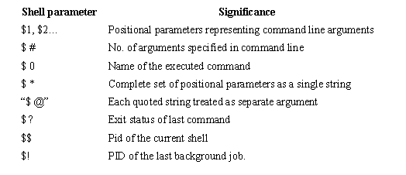
Using Command Line Arguments

Slide 116
Variables and arrays
Variables
a=2
b=2.2
c=‘A’
d=“Hello”
Arrays
A[$i]=$value
Display ${a[i]}

Slide 117
The if Conditional
Form 1 Form 2 Form 3
if command is successful if command is successful if command is successful
then then then
execute commands execute commands execute commands
fi else elif command is successful
execute commands then...
fi else...
fi
If the command succeeds, the statements within if are executed or else statements in else block are executed (if else is present).

Slide 118
Using test and [ ] to Evaluate Expressions
Test statement is used to handle the true or false value returned by expressions.
Test uses certain operators to evaluate the condition on its right
Returns either a true or false exit status
Is used by if for making decisions.
Test works in three ways:
Compare two numbers
Compares two strings or a single one for a null value
Checks files attributes
Test doesn’t display any output but simply returns a value that sets the parameters $?

Slide 119
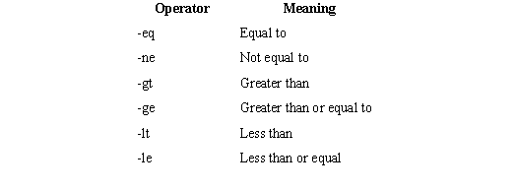
Using test and [ ] to Evaluate Expressions
Numeric Comparison

Slide 120
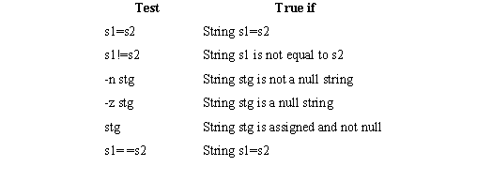
Using test and [ ] to Evaluate Expressions
String Comparison

Slide 121
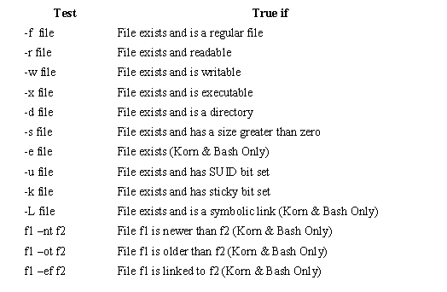
File Tests

Slide 122
The case Conditional
Syntax:
case expression in
Pattern1) commands1 ;;
Pattern2) commands2 ;;
Pattern3) commands3 ;;
…
esac

Slide 123
expr: Computation and String Handling
The Bourne shell uses expr command to perform computations and string manipulation.
expr can perform the four basic arithmetic operations (+, -, *, /), as well as modulus (%)
functions.
Computation:
Example1 :$ x=3 y=5
$ expr $x+$y
8 → Output
Example 2:$ expr 3 \* 5
15 → Output
Note: \ is used to prevent the shell from interpreting * as metacharacter

Slide 124
Cont…
Length of the string:
The regular expression .* is used to print the number of characters matching the pattern .
Example: $expr “abcdefg” : ‘.*’ (o/p → 7)
Extracting a substring:
expr can extract a string enclosed by the escape characters \ (and \).
Example:$ st=2007
$ expr “$st” :’..\(..\)’ (o/p → 07)
Locating position of a character:
expr can return the location of the first occurrence of a character inside a string.
Example: $ stg = abcdefgh ; expr “$stg” : ‘[^d]*d’
(o/p →4)

Slide 125
For : Looping
More examples of for loop
for i in *
do
cat $i
done | grep sh > sh.out #note where loop output goes
Try these examples of some for loop header lines
for i in $*
for i in `cat file.lst`
for i in 2 4 6

Slide 126
While : Looping
While loop
while <command_list>
do
<command_list>
Done
Example:
cnt=1
while test $cnt -ne 5
do
echo $cnt
cnt = `expr $cnt + 1`
done

Slide 127
Functions
Function Call
Func a b
Stat=$?
Function defination
Func()
{
arg1=$1
Arg2=$2……
Commands;
Return value;
}

Slide 128
Other Application Interface

Slide 129
sqlplus
#!/usr/bin/ksh Blah=$1 .... sqlplus system/manager@testdb1 << EndOfFile select * from dual ; {blah blah blah} quit EndOfFile {more shell script}

Slide 130
sqlplus
sqlplus -s scott/tiger <<EOF
SET SERVEROUTPUT ON
SET FEED OFF spool aaa.txt BEGIN DBMS_OUTPUT.PUT_LINE('xyz'); END; / spool off EOF
sqlplus -s scott/tiger <<EOF
SET SERVEROUTPUT ON
SET FEED OFF spool aaa.txt
BEGIN
DBMS_OUTPUT.PUT_LINE('xyz');
END; / spool off EOF
set serveroutput <ON | OFF> - Display Output From DBMS_OUTPUT.PUT_LINE built-in package
SET COLSEP <column separator> - Column Separators - SET COLSEP ‘,’
SET HEAD <OFF | ON> - display headers
SET LINESIZE <integer> , SET PAGESIZE <integer>
exec demoexec – Run Stored Procedure
Run Script : @ <path_and_script_name> @c:\oracle\product\ora102\rdbms\admin\catplan.sql

Slide 131
Calling Other Programs
Java
Define Your class path if nessasary , if not it will take the global classpath
Java cp -$classpath –Dvar1 –Dvar2 com.db.dbiq.classname
When you run with java check the JAVA_HOME and PATH
C or C++
gcc <main.c> -o <main.out>
g++ main.cpp then type main.out

